Slide 1

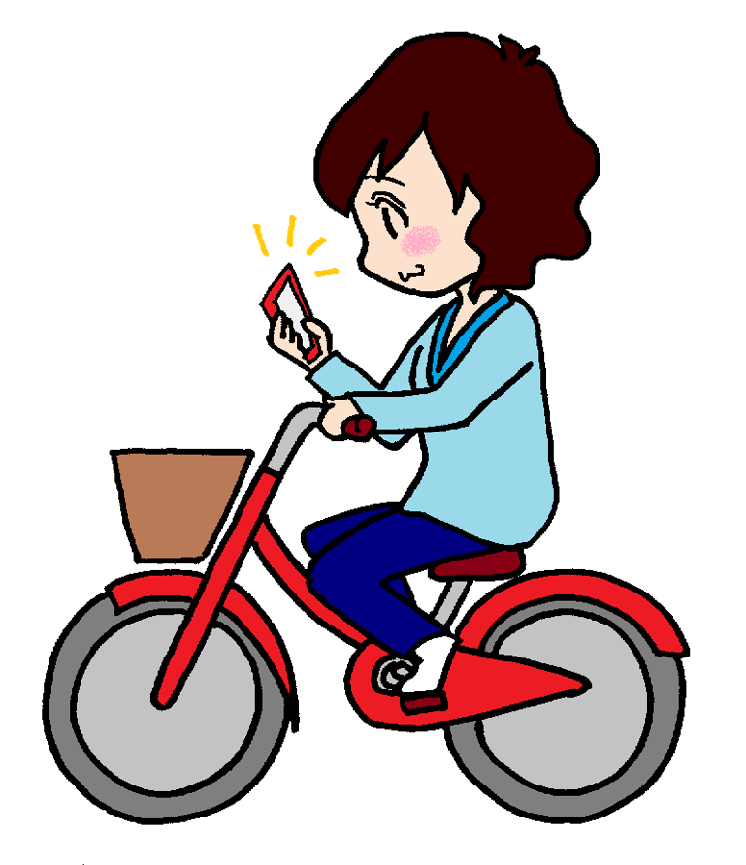
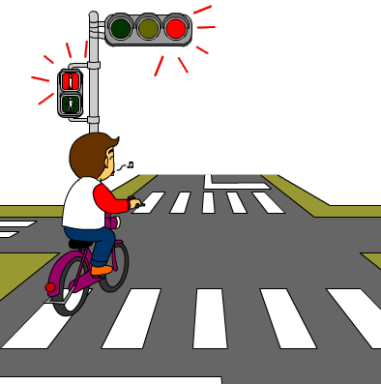
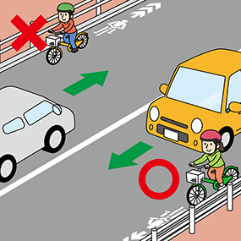
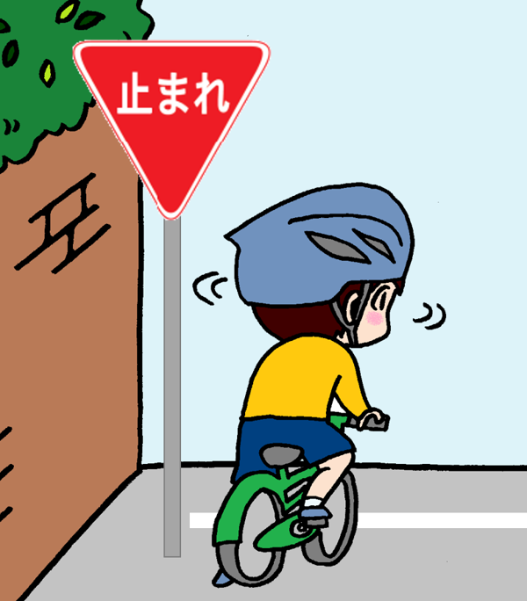
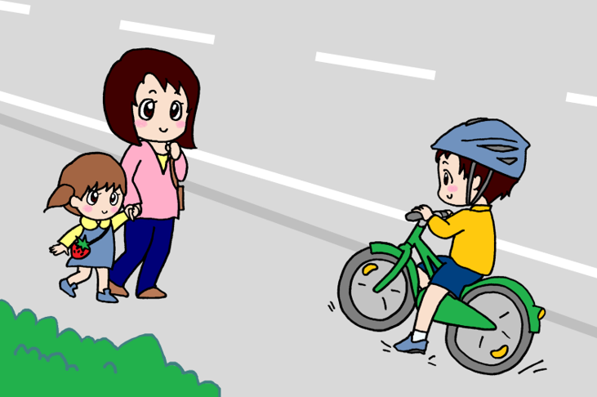

Safe Cycling Starts with Following Regulations Hida Police Station
Failure to follow cycling regulations is a traffic violation.
It is illegal to use a mobile phone while cycling.
It is illegal to disregard traffic signals; You can only cross the street when the lights are green.
It is illegal to ride a bike on the right hand side of the road.
It is illegal to cross the street at signs marked “STOP” or “止まれ” without coming to a complete stop and checking that the intersection is clear.
Riding a bike on the sidewalk is illegal;
however, it may be permitted under the following circumstances:
①where a sign permits cycling on the pavement.
②when the rider is under 13, over 70, or has a
physical disability.
③when traffic on the road is congested, or when the road
lacks sufficient width.
Sign

